Slide 1
PSYCHOTHERAPY FOR STRESS AND ANXIETY AMONG YOUNG ADULTS
Under the Guidance of
DR. A JOHN BALAIAH
ROMIMOL M
22PCP824

Slide 2
RESEARCH DESIGN
CHAPTER 1 : INTRODUCTION
CHAPTER 2 : REVIEW OF LITERATURE
CHAPTER 3 : RESEARCH METHODOLOGY
CHAPTER 4 : DATA ANALYSIS AND INTERPRETATIONS
CHAPTER 5 : SUMMARY AND CONCLUSIONS

Slide 3
normal reaction to everyday pressures
an emotion characterized by feelings of tension, worried thoughts, and physical changes like increased blood pressure.
Generalized Anxiety Disorder (GAD)
Panic disorder,
Social Anxiety Disorder (SAD),
Specific phobias,
Eustress
Neustress
Hyperstress
Hypostress

Slide 4
CHAPTER 2: REVIEW OF LITERATURE

Slide 5
LEARNINGS
The stress experienced by the young adults who go through are comparatively greater than those who have settled which has impact on their decision making.
Normative transitions do not cause high stress levels but the unusual changes or delays contribute their increase levels of stress and anxiety
The adolescent anxiety has an impact on the psychosocial outcomes of the individuals during their later at the age of 30
Facebook depression and cyberbullying and impact of social media has an impact on young adults expecially adolescent girls and women in early adulthood.
“Age differences in the presentation of anxiety” – study says older adults report less worry and stress than younger adults
“Test Anxiety in elderly and young adults” – study says that elderly college students has higher levels of anxiety than the younger college students which are proved to be true.
Negative thinking and maladaptive behavior is directly related to anxiety among college students
Women show higher perceived stress than men
I would like to know more about how family contributes to stress and anxiety among college students.

Slide 6
CHAPTER 3 : RESEARCH METHODOLOGY

Slide 7
STATEMENT OF THE PROBLEM
OBJECTIVES
To assess the levels of stress and anxiety among young adults aged 18 to 30.
To study what contributes the increased level of stress and anxiety among college students compared to the working individuals
To propose strategies and techniques to deal with stress and anxiety
To foster the study skills and personality development of the students
HYPOTHESIS
Young adults aged 18 to 30 will exhibit varying levels of stress and anxiety, with a significant proportion experiencing moderate to high levels of psychological distress.
The transitory character of life events influences the degrees of stress and anxiety.
Young adults between the ages of 18 and 25 have higher levels of stress and anxiety than people 26 years of age and older.
The students who are in the period of transition face increased level of stress and anxiety than those who have settled.

Slide 8
RESEARCH PROCEDURE
SCALES USED – PSS and BAI
SENT THROUGH GOOGLE FORM LINKS PERSONALLY TO EVERY INDIVIDUALS
THE POPULATION WERE YOUNG ADULTS OF AGE 18 TO 30
AMONG 300 PEOPLE 100 RESPONDED
THE RESPONDERS WERE EAGER AND EXCITED TO KNOW ABOUT THEIR STRESS AND ANXIETY LEVELS.
CHALLENGES FACED:
IT WAS DIFFICULT TO CONTACT MANY OF THEM
LESS NO.OF REPONDERS
TOOK LOTS OF TIME FOR REPONDING THE QUESTIONS

Slide 9
CHAPTER 4 : DATA ANALYSIS AND INTERPRETATIONS

Slide 10
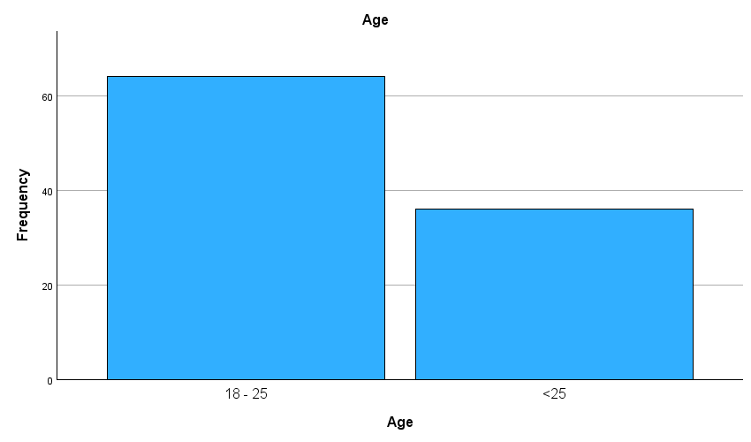
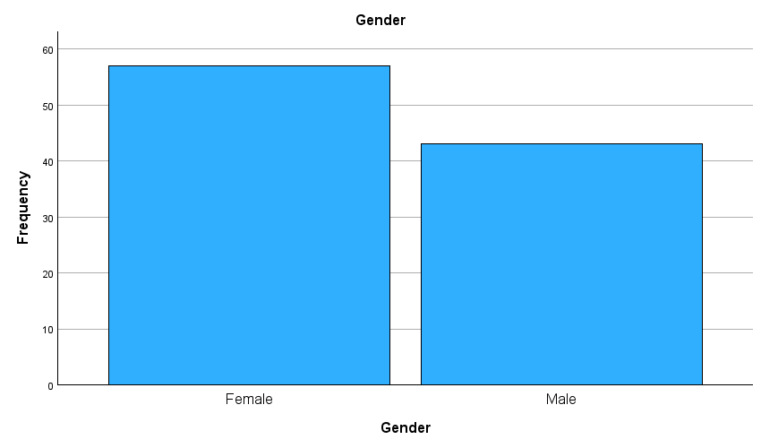
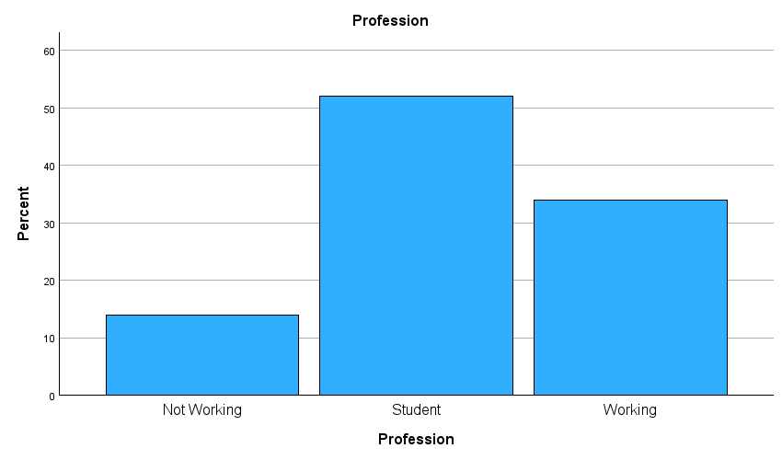
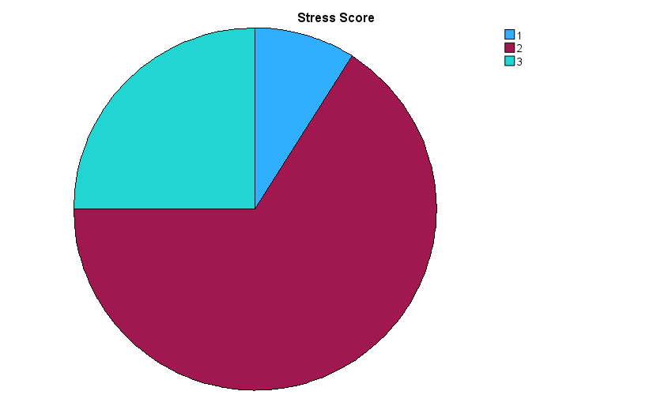
AGE
GENDER
LOW
MEDIUM
HIGH
PROFESSION
STRESS SCORE

Slide 11
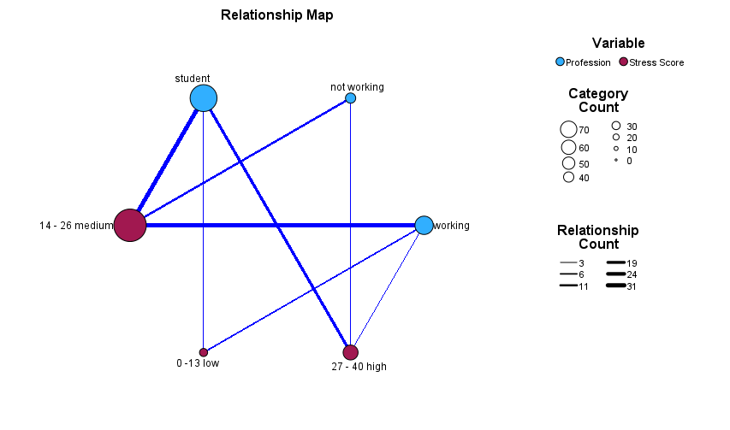
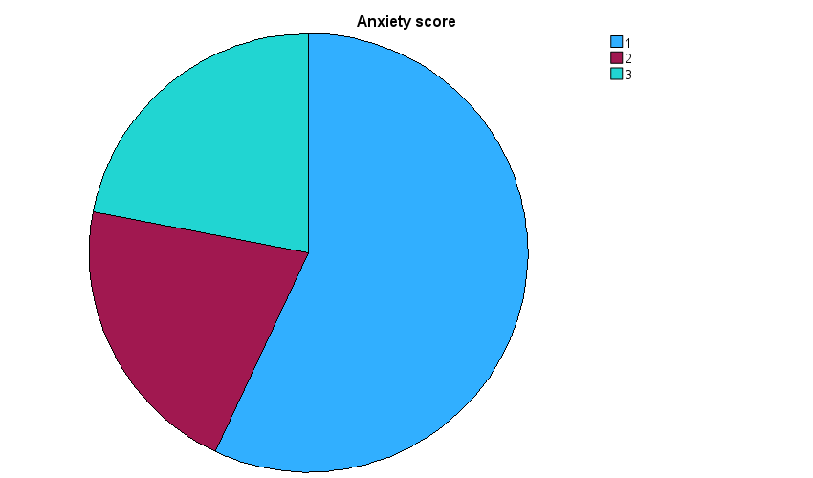
ANXIETY SCORE
LOW
MEDIUM
HIGH

Slide 12
Correlations
Control Variables |  |  | Stress Score | Anxiety score
Age | Stress Score | Correlation | 1.000 | .355
 |  | Significance (2-tailed) | . | <.001
 |  | df | 0 | 97
 | Anxiety score | Correlation | .355 | 1.000
 |  | Significance (2-tailed) | <.001 | .
 |  | df | 97 | 0
SIGNIFICANT RELATIONSHIP
FOUND BASED ON AGE
Correlations
Control Variables |  |  | Stress Score | Anxiety score
Profession | Anxiety score | Correlation | 1.000 | .331
 |  | Significance (2-tailed) | . | <.001
 |  | df | 0 | 97
 | Stress Score | Correlation | .331 | 1.000
 |  | Significance (2-tailed) | <.001 | .
 |  | df | 97 | 0
SIGNIFICANT RELATIONSHIP
FOUND BASED ON PROFESSION

Slide 13
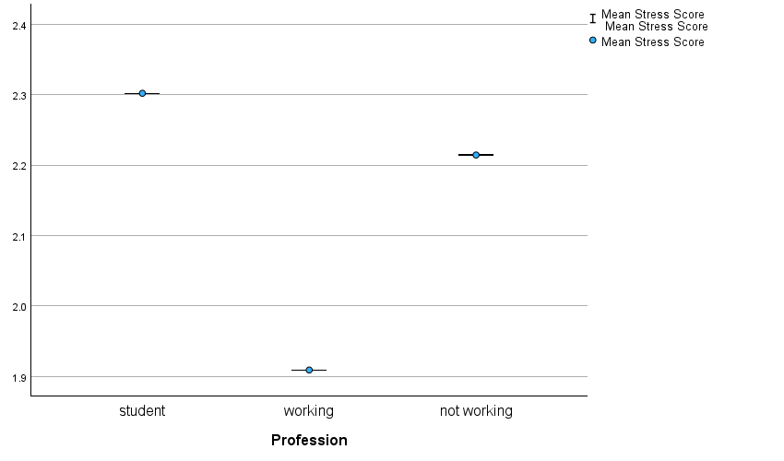
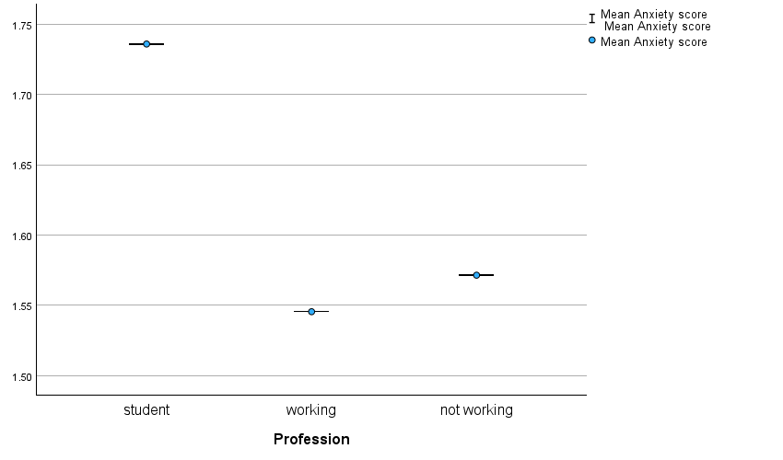
THE ANXIETY SCORE
THE STRESS SCORE

Slide 14
CHAPTER 5 : SUMMARY AND CONCLUSIONS

Slide 15
FINDINGS:
significant variations in stress and anxiety levels among young adults, with a notable proportion experiencing moderate to high levels of anxiety.
The data indirectly supports this hypothesis by identifying demographic factors such as profession and age as contributors to differences in stress and anxiety levels among young adults, suggesting that life events may indeed influence stress and anxiety experiences.
The data confirms this hypothesis by demonstrating a positive correlation between age and both stress and anxiety scores, indicating that older individuals tend to experience higher levels of stress and anxiety.

Slide 16
SUMMARY
The stress experienced by the young adults who go through are comparatively greater than those who have settled which has impact on their decision making.
Normative transitions do not cause high stress levels but the unusual changes or delays contribute their increase levels of stress and anxiety
THE ANXIETY LEVEL OF THE WORKING PEOPLE IS HIGHER THAN THEIR STRESS LEVEL

